Slide 1

Employee Management System
C. B. Praneetha
Batch Number: 536

Slide 2
About me
Background? (B-tech or M-tech): I am a B. Tech graduate in Electrical and Electronics Engineering (EEE) from G. Pulla Reddy Engineering College. I completed my B. Tech in 2025.
Why you want to learn Data Science: Coming from an EEE background, I wanted to move into the IT and data field. I became interested in Data Analytics because I enjoy working with data, finding patterns, solving problems, and using data to support business decisions. I am currently developing my skills in Python, SQL, Excel, Power BI, and Tableau.
Work experience: I am a fresher and do not have professional work experience yet. I have worked on academic and training projects, including Customer Churn Analysis using Power BI, an Employee Management System using SQL, and Python projects
LinkedIn and GitHub profile URLs: https://www.linkedin.com/in/cb-praneetha-0b89b9286/ and https://github.com/Praneethachittari

Slide 3
Agenda
Business Problem
Business statement
Objective of the Project
Introduction
Data Description
Queries and Outputs
Key insights
Recommendations
Conclusion

Slide 4
Business Problem
Organisations manage large amounts of employee information such as employee details, departments, salaries, bonuses, leaves, and payroll. When this information is stored across multiple tables, it can become difficult to analyze and generate reports efficiently.
The HR team needs a reliable system to retrieve employee information, analyze salary and leave patterns, understand department-wise workforce distribution, and support better decision-making.

Slide 5
Business Statement
The Employee Management System is developed to centralize and manage employee, department, salary, qualification, leave, and payroll information in a structured relational database. The system uses SQL to analyze this data and provide meaningful insights that help HR and management make informed decisions related to workforce planning, compensation, leave management, and payroll.

Slide 6
Objective of the Project
The main objective is to use SQL to manage, analyse, and retrieve employee data efficiently.
The project aims to:
Analyze employee distribution across departments.
Analyze salary and bonus information.
Understand employee leave patterns.
Calculate payroll-related information.
Identify useful employee and department-level insights.
Practice real-world SQL concepts such as Joins, aggregate functions, Group by, Having, subqueries, and filtering.

Slide 7
Introduction
The Employee Management System (EMS) is a SQL-based project designed to manage and organize employee-related information within an organization. The main purpose of this system is to maintain employee records and make it easier to manage job roles, departments, salaries, bonuses, leaves, and payroll information in a structured way.
In this project, I created multiple related tables to represent different areas of employee management. Employee details are connected with their respective job departments and roles, while salary and bonus information is maintained separately. The system also stores leave records and payroll details, which helps in analyzing employee compensation and attendance-related information.
I used MySQL to create the database, define tables, establish relationships using primary keys and foreign keys, and perform different types of SQL queries. I also used concepts such as JOINs, subqueries, aggregate functions, GROUP BY, HAVING, ORDER BY, DISTINCT, and correlated queries to generate meaningful business insights from the data.
Overall, this project demonstrates how SQL can be used to build a structured employee database and generate useful reports that can support HR, payroll, and management decision-making.

Slide 8
Data Description
Table Name | Column Name | Data Type
Job Department | Job_ID | INT
 | jobdept | VARCHAR(50)
 | name | VARCHAR(100)
 | description | TEXT
 | salaryrange | VARCHAR(50)
Employee | emp_ID | INT
 | Job_ID | INT
 | name | VARCHAR(100)
 | gender | VARCHAR(20)
 | email | VARCHAR(100)
 | phone | VARCHAR(15)
SalaryBonus | salary_ID | INT
 | emp_ID | INT
 | salary | DECIMAL(10,2)
 | bonus | DECIMAL(10,2)A

Slide 9
Table Name | Column Name | Data Type
Qualification | qualification_ID | INT
 | emp_ID | INT
 | qualification | VARCHAR(100)
 | institution | VARCHAR(100)
 | year | YEAR
Leaves | Leaves_ID | INT
 | Emp_ID | INT
 | Leave_type | VARCHAR(50)
 | Start_date | DATE
 | End_date | DATE
 | Status | VARCHAR(30)

Slide 10
Table Name | Column Name | Data Type
Payroll | emp_ID | INT
 | Job_ID | INT
 | Salary_ID | INT
 | Leave_ID | INT
 | Date | DATE
 | Report | TEXT
 | Total_Amount | DECIMAL

Slide 11
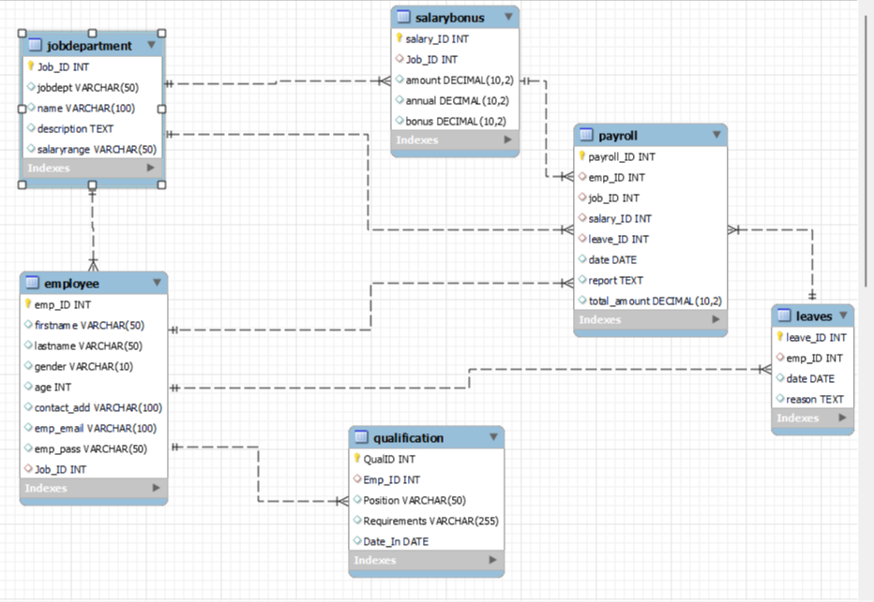
ER Diagram – Key Points

Slide 12
Cardinalities
Parent Table | Child Table | Cardinality
JobDepartment | Employee | 1 : N
Employee | SalaryBonus | 1 : N
Employee | Qualification | 1 : N
Employee | Leaves | 1 : N
Employee | Payroll | 1 : N
JobDepartment | Payroll | 1 : N
SalaryBonus | Payroll | 1 : N
Leaves | Payroll | 1 : N

Slide 13
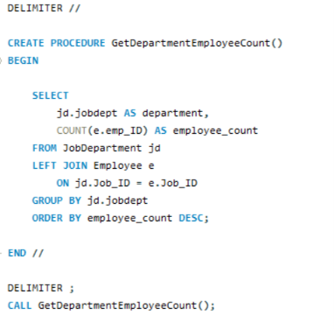
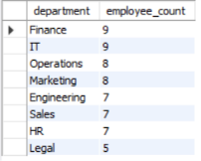
1. Which departments have the highest number of employees?

Slide 14
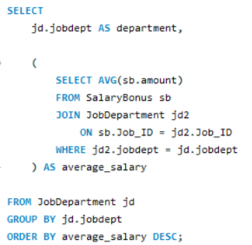
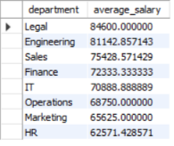
2. What is the average salary per department?

Slide 15
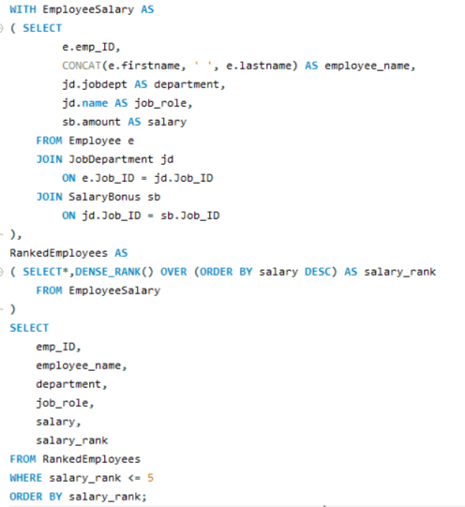
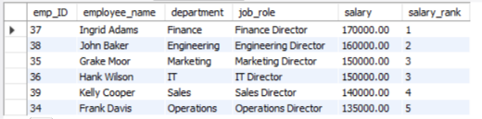
3. Who are the top 5 highest-paid employees?

Slide 16
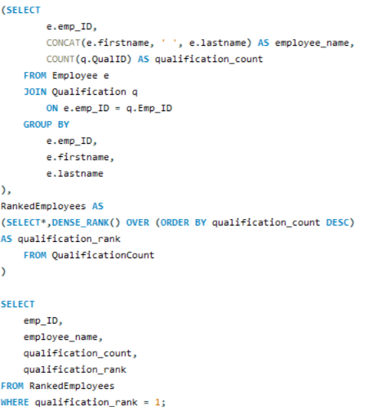
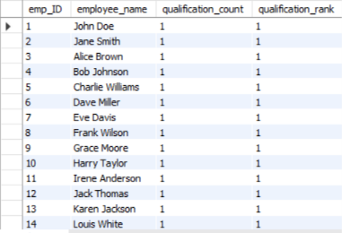
4. Which employees have the highest number of qualifications?

Slide 17
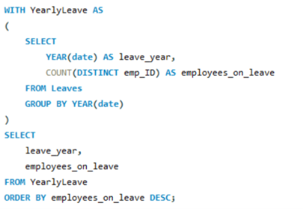

5. Which year had the most employees taking leaves?

Slide 18
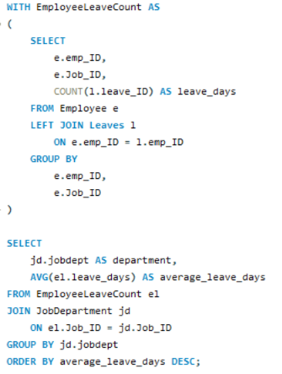
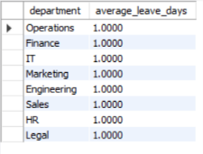
6. What is the average number of leave days taken by employees per department?

Slide 19
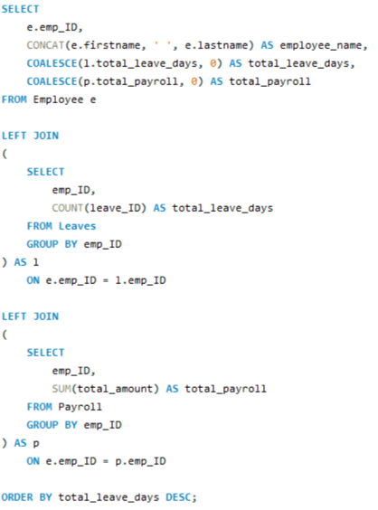
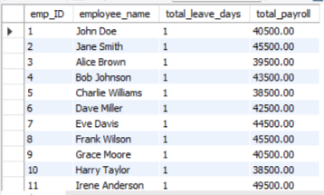
7. How do leave days correlate with payroll amounts?

Slide 20
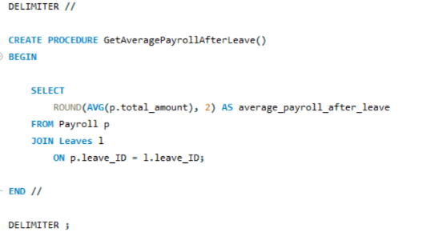

8. What is the average value of total_amount after considering leave deductions?

Slide 21
Key Insights
Identified the total number of unique employees in the organization.
Analyzed employee distribution across departments to identify departments with higher workforce strength.
Compared average salaries across departments to understand compensation differences.
Identified the highest-paid employees and job roles, helping understand salary patterns.
Analyzed qualification requirements and identified positions requiring more qualifications.
Identified the year with the highest number of employees taking leaves, helping understand leave patterns.
Calculated the average leave days by department to compare employee absence patterns.
Analyzed monthly payroll expenditure to understand payroll trends over time.
Compared bonus distribution across departments to identify departments receiving higher bonuses.
Used the analysis to support HR planning, workforce management, compensation decisions, and payroll monitoring.

Slide 22
Recommendations
Workforce Planning: Departments with higher employee counts can be monitored to ensure proper workload distribution and staffing.
Salary Review: Salary differences across job roles and departments can be reviewed to maintain fair and competitive compensation.
Qualification Development: Employees can be provided with relevant training and skill-development programs based on job requirements.
Leave Management: Departments with higher leave patterns can be analyzed to understand absence trends and improve workforce planning.
Payroll Monitoring: Monthly payroll can be regularly tracked to identify changes in payroll expenditure and maintain financial control.
Bonus Management: Bonus allocation can be reviewed to ensure rewards are aligned with employee performance and organizational goals.

Slide 23
Conclusion
The Employee Management System successfully demonstrates how SQL can be used to manage and analyze organizational data. The project connects employee, department, salary, qualification, leave, and payroll information through relational database design.
Using SQL queries, the project provides insights into employee distribution, salaries, qualifications, leave patterns, payroll, and bonuses. These insights can help HR and management make better workforce, compensation, and payroll-related decisions.
Overall, the project demonstrates the practical use of SQL for data management, analysis, and business decision-making

Slide 24
Q & A

Slide 25

THANK YOU

